Slide 1

INVENTORY MANAGEMENT SYSTEM FOR MTE LAB
Course No: CSE-2188
Course Title: Software Engineering Sessional
RAJSHAHI UNIVERSITY OF ENGINEERING & TECHNOLOGY

Slide 2
Presented by Group – 11
Jubayer Al Mahmud (1908056)
Md. Sameer Yamin (1908057)
Enamul Hasan Shagato (1908058)
Md. Muddassir Fuad (1908059)
Sakibul Islam (1908060)
Sanim zubayer (1808013)
Under the supervision of
Md. Faisal Rahman Badal, Lecturer, Dept. of Mechatronics Engineering, RUET.
Md. Mehedi Hasan, Lecturer, Dept. of Mechatronics Engineering, RUET.

Slide 3
Contents
Project summary.
Platform & language.
Features.
Project progress.
Installation process
Interface
Source code.
Future plans.

Slide 4
Project summary
Our Inventory management system is basically used for sorting and keeping records of lab equipment. The software includes some critical components. Such as incoming and outgoing materials, raw material entry sheet, daily expenditure and most importantly the list of waste and faulty products.

Slide 5


Platform & language
Visual studio
Python

Slide 6
Visual studio is used to develop the software. The particular software will only run on windows operating system.
Python is used for the programming language of the software as Python is a high level programming language with oop support. Most importantly python offers usage of customable GUI’s from scratch.

Slide 7
Features
Calculate current stocks.
Record details of the products ( Name, details, entry date)
Edit, search and indexing data.
Keep records of daily used products and wastes.
Display what items needs to be restocked.

Slide 8
Project progress
Progress we have done till now:
We designed our gui using tkinter library from python programming language.
We made database using Sqlite3.
We connect gui and database using backend.py file.
Finally we are able to make the final interface of the software.

Slide 9
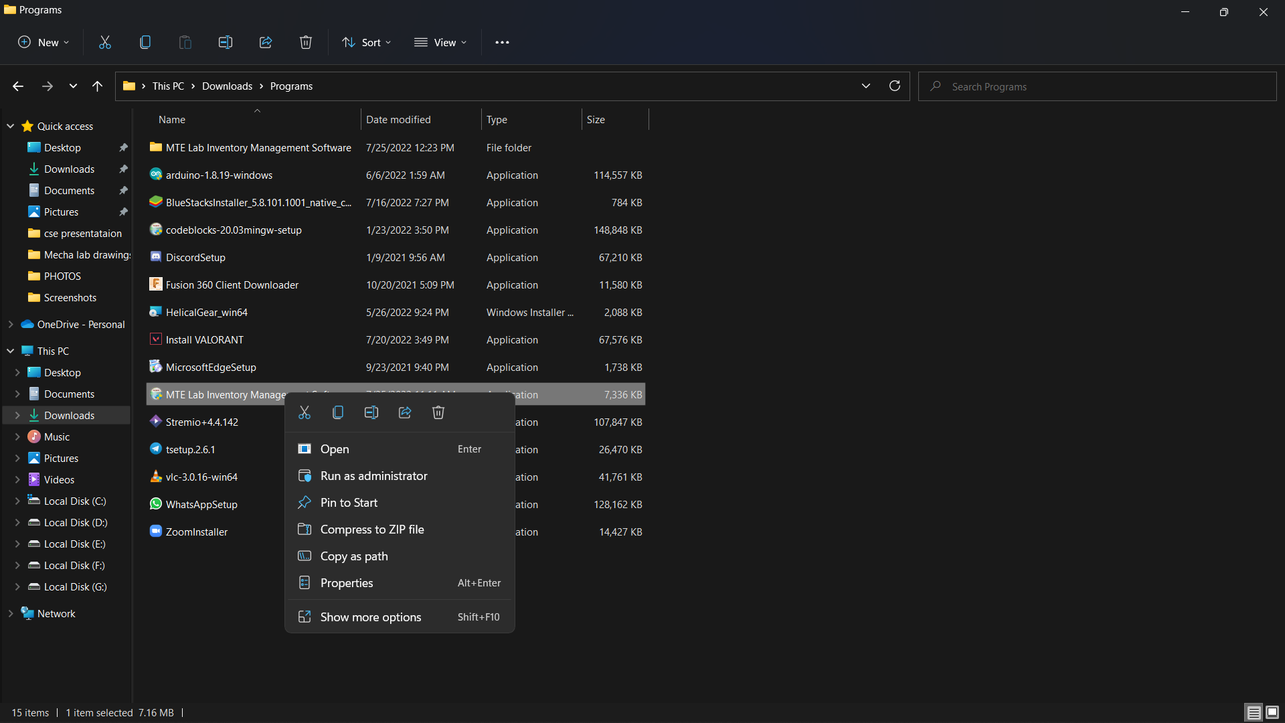
Installation process
Step 1: Download the setup folder from web.
MTE Lab Inventory Management Software.exe - Google Drive
Step 2: Open the setup folder from download directory.

Slide 10
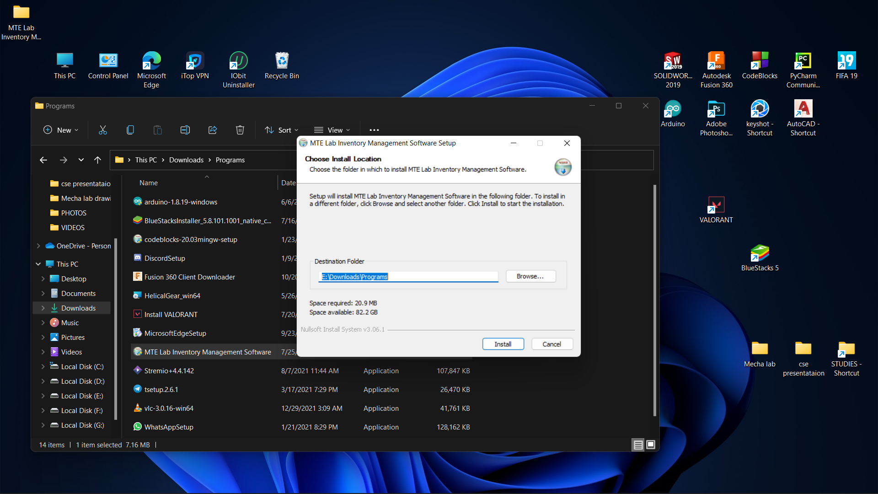
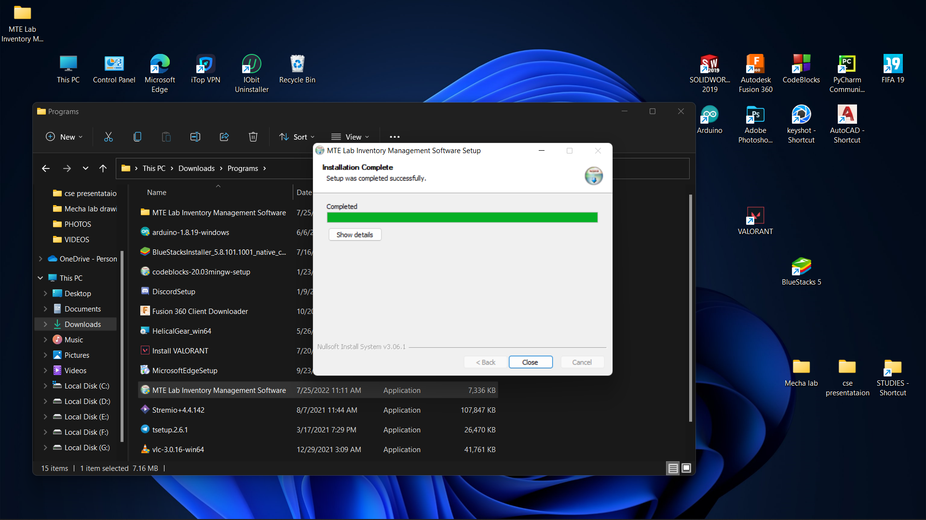
Step 3: Select the installation path for the software :
Step 4: Press close after completion of the software.
Jul-25
Inventory management system
10

Slide 11
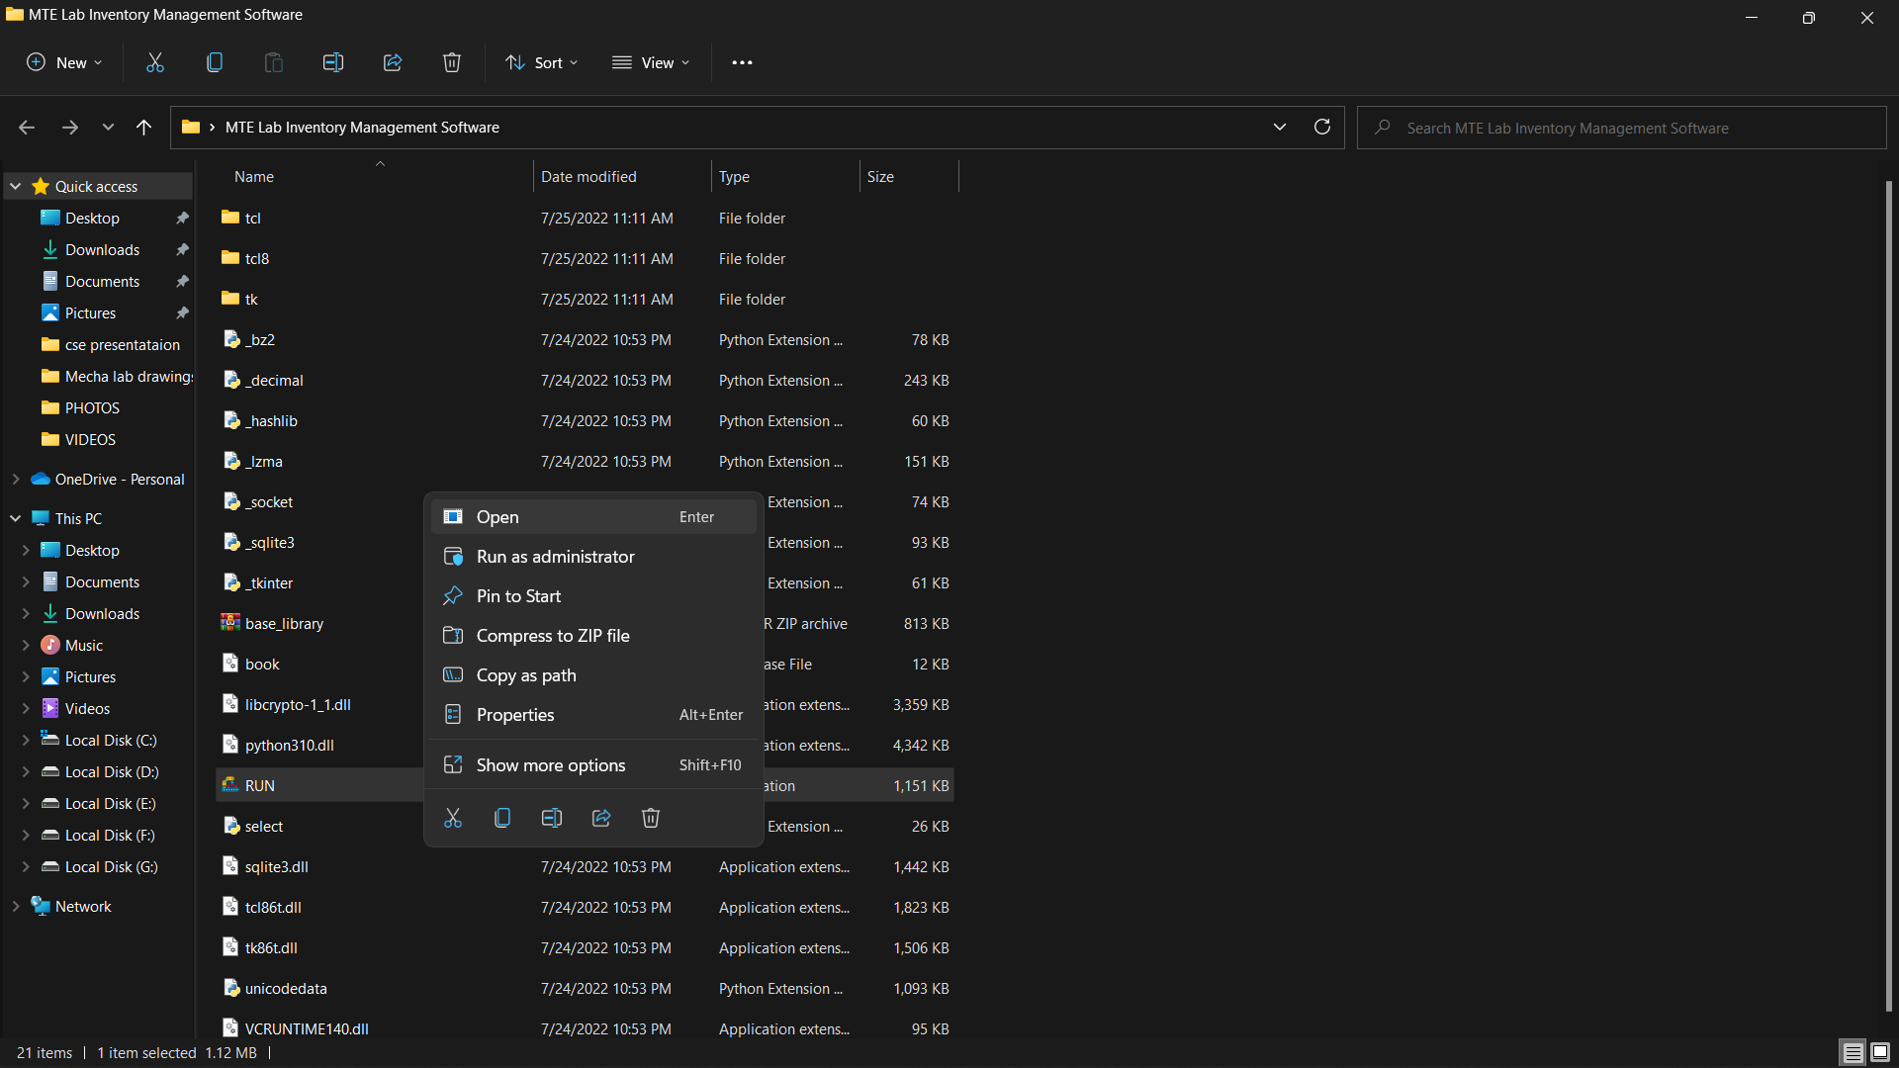
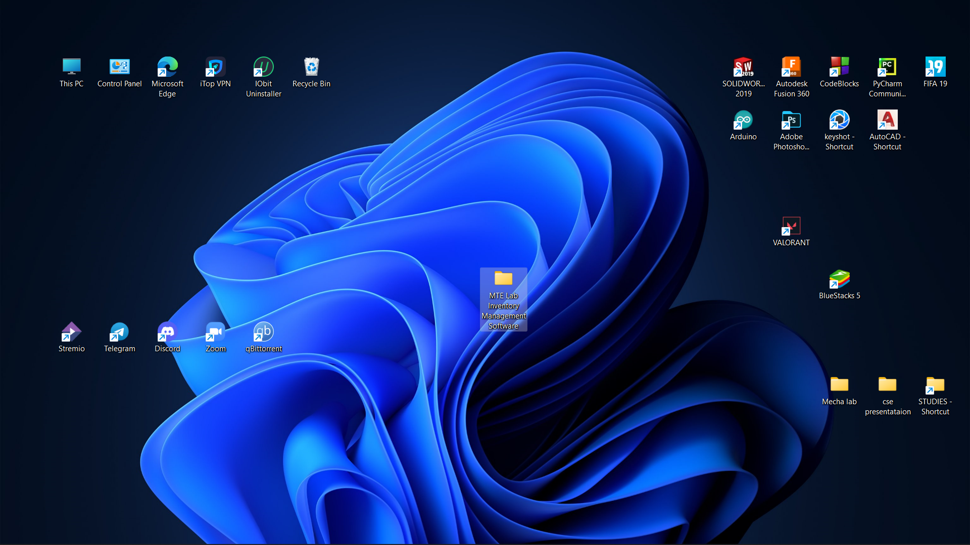
Step 5: After completing step 4 a folder named “Mte Lab Inventory Management Software” will appear and in the folder the “Run” file will open the software.

Slide 12
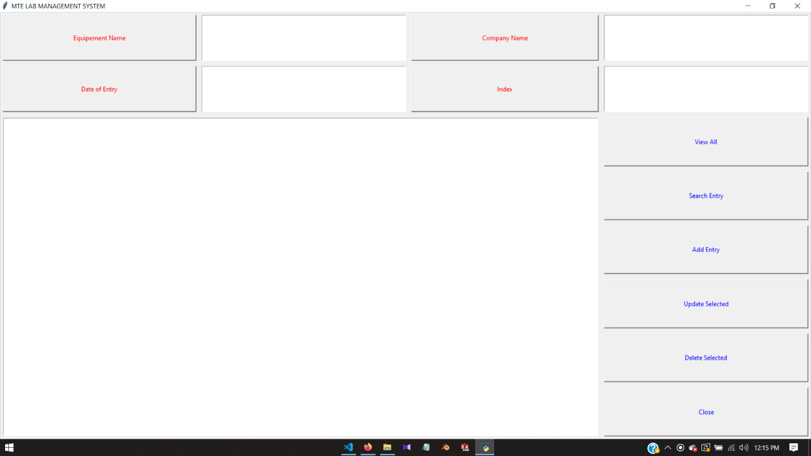
INTERFACE

Slide 13
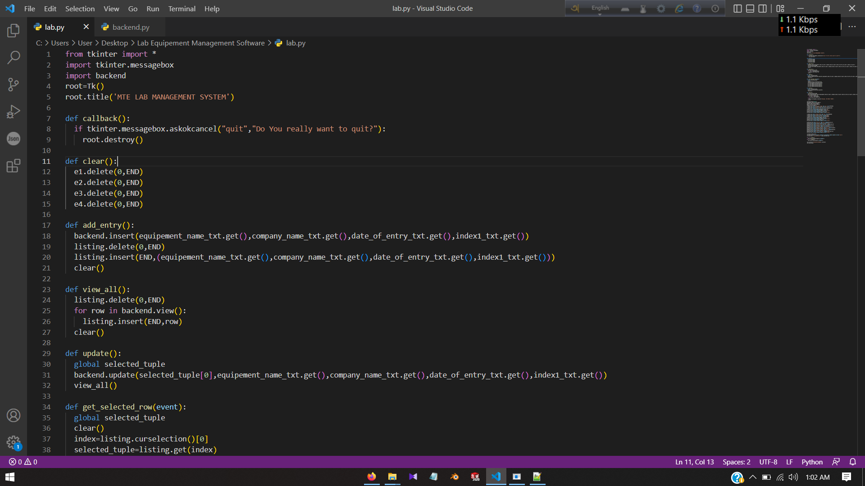
Source code: UI(frontend)

Slide 14
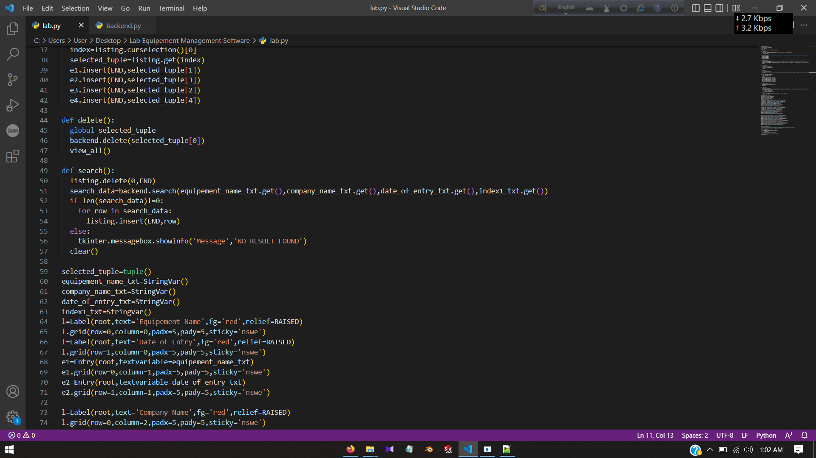

Slide 15
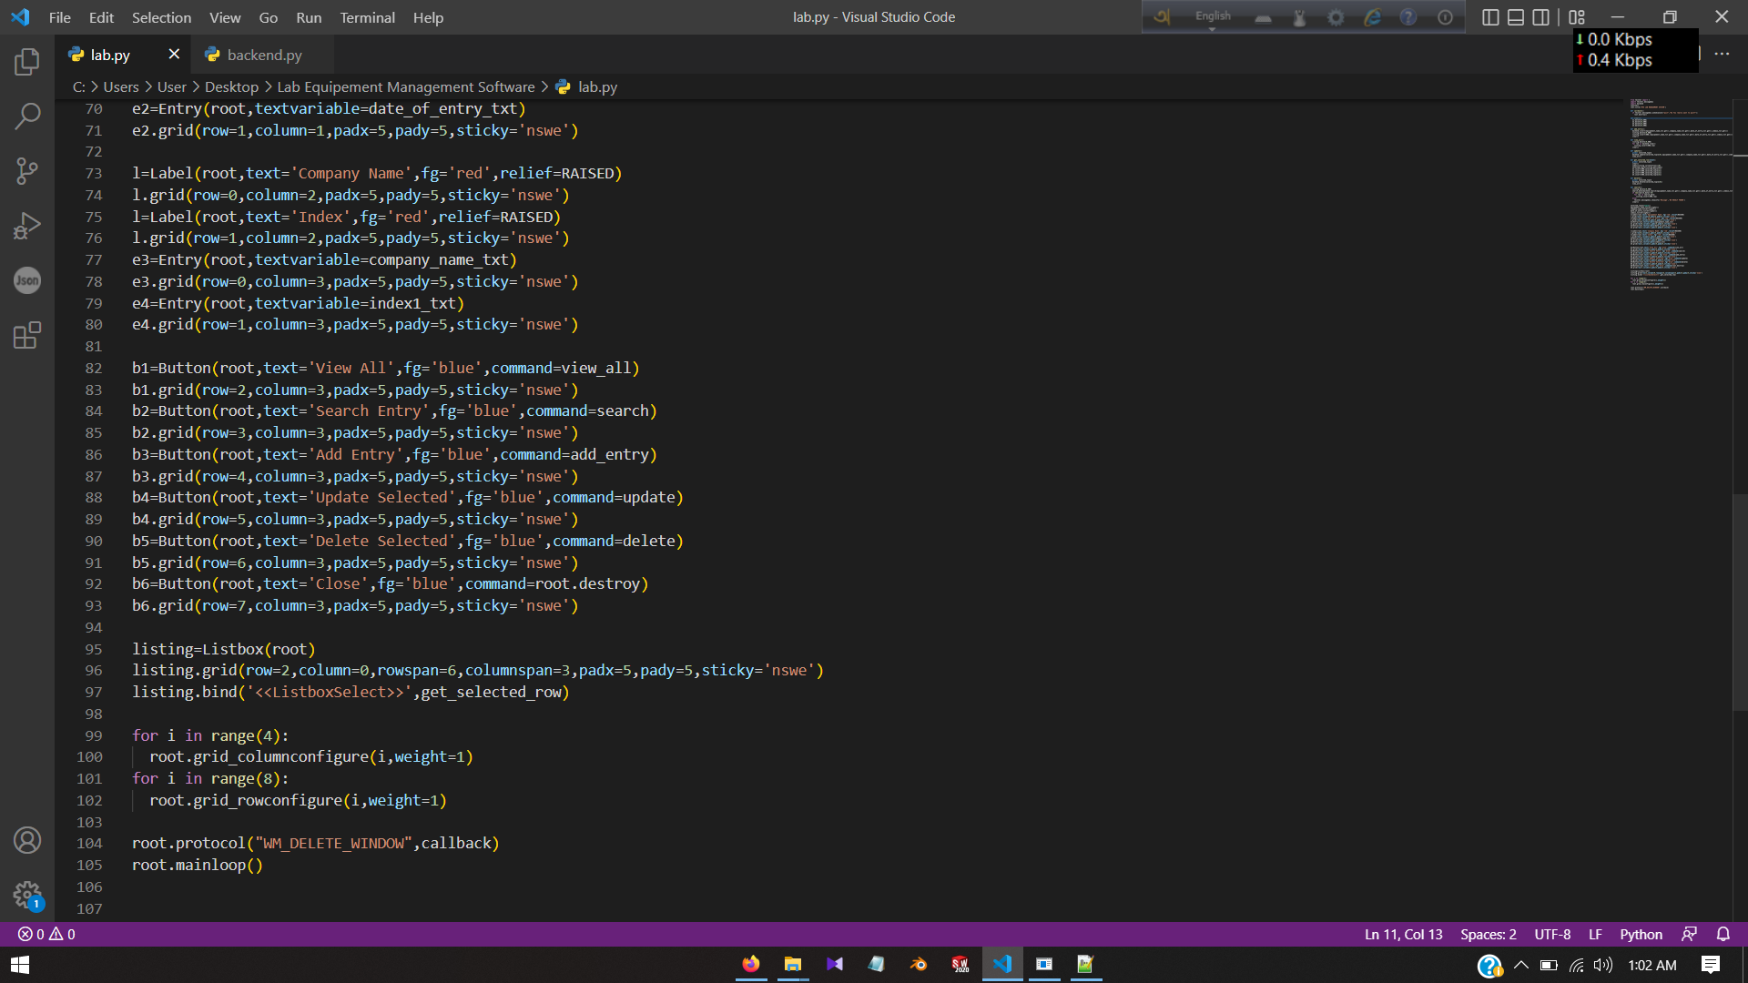

Slide 16
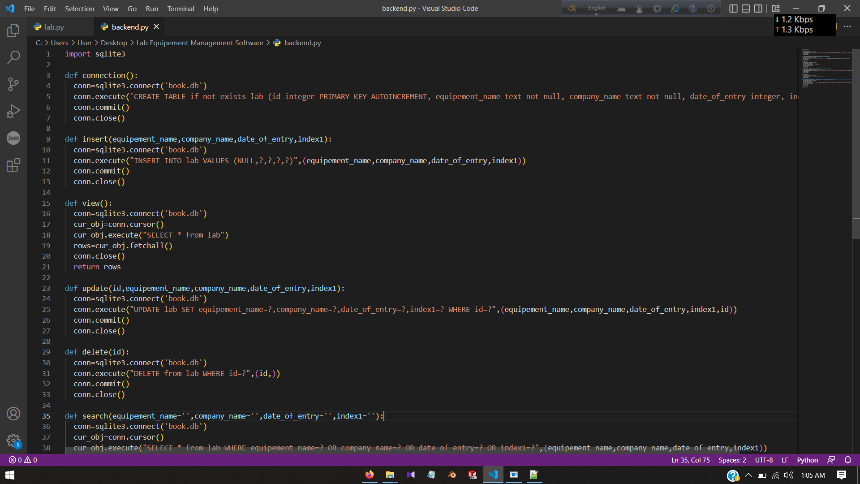
Source code: backend

Slide 17
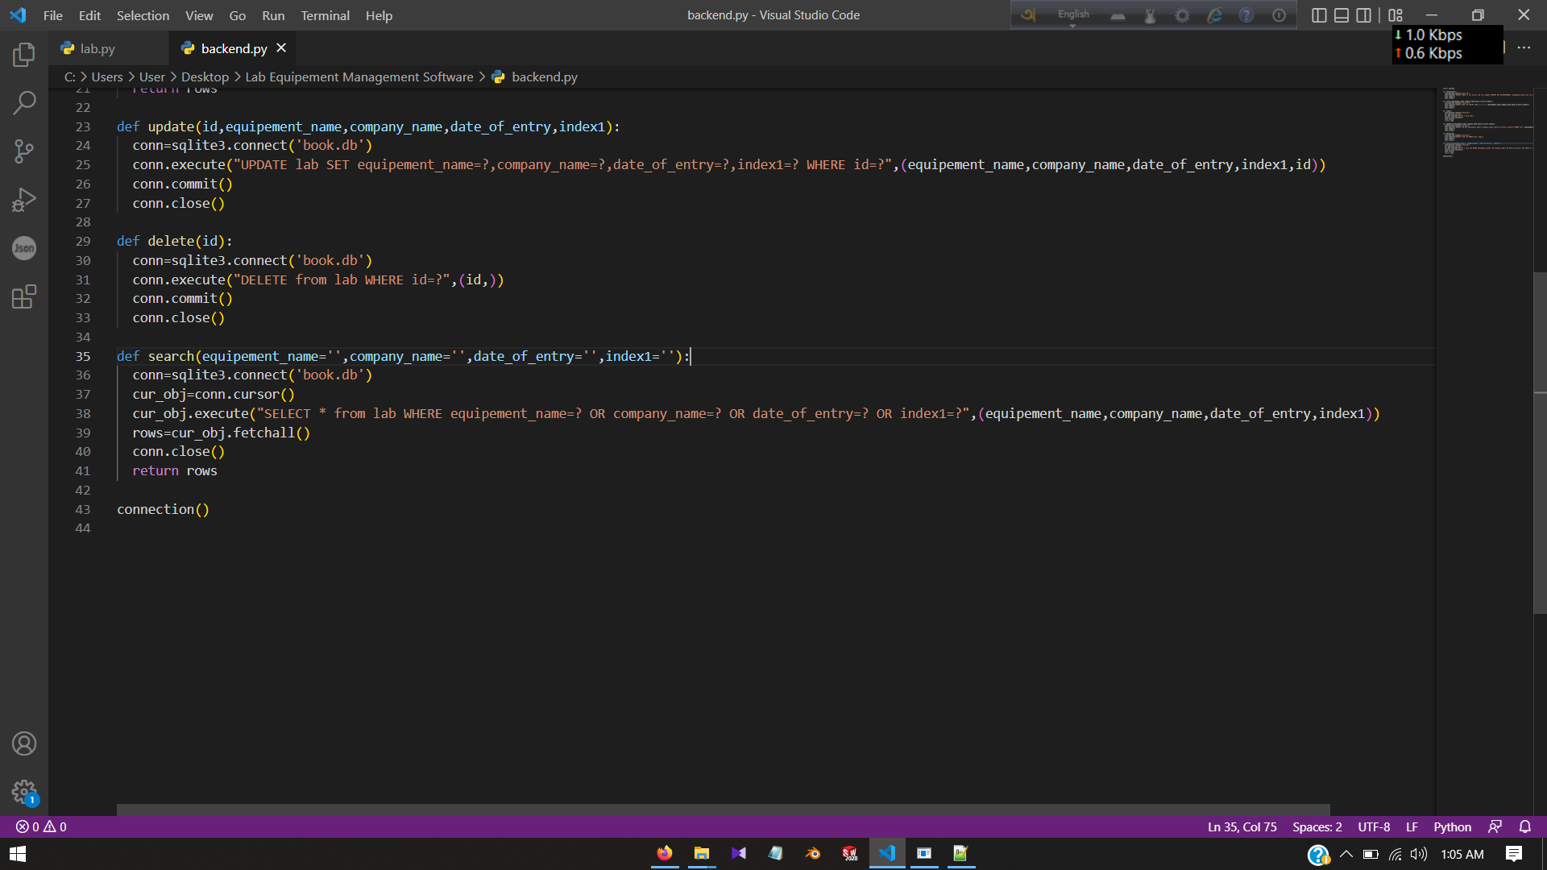

Slide 18
Future of this project
We will add User Account Creation page and Log in page in the software. Moreover work on UI of the software to make the software attractive and more user friendly and will add barcode scanner.
The main purpose to built this software is to keep track of all the goods coming and going out of the Mechatronics Lab. This software can only be conducted by the lab authority and the lab staffs. So there is no scope for data traffic and product missing. After making this software we believe that it will help to organize our MTE Lab equipment and take a step forward to digitalize our lab.

Slide 19
ANY QUESTIONS?

Slide 20
THANK YOU

